Slide 1
Progress Update
Hurricane Wind Speed Prediction Using Deep Learning and Machine Learning

Slide 2
Milestones
October 19: Completing of preparation of images for baseline model and implementation and initial results of baseline model.
November 2: Hyperparameter Tuning results for baseline model. Completion of preparation of images for pre-trained models (converting single-band images to RGB images based on timestep).
November 16: Completion of pre-trained model training, hyperparameter tuning.
November 30: Training classifier and constructing a pipeline for the proposed architecture.
December 14: Model evaluation and Performance Comparison. Completion of Final Report.

Slide 3
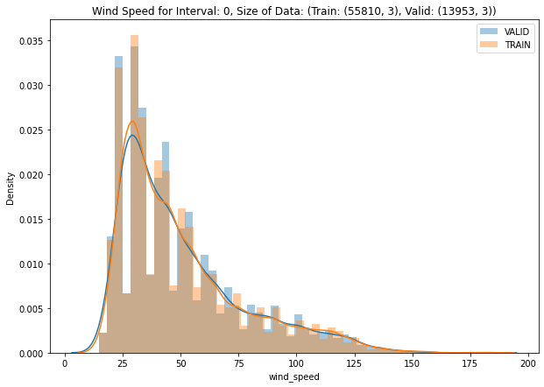
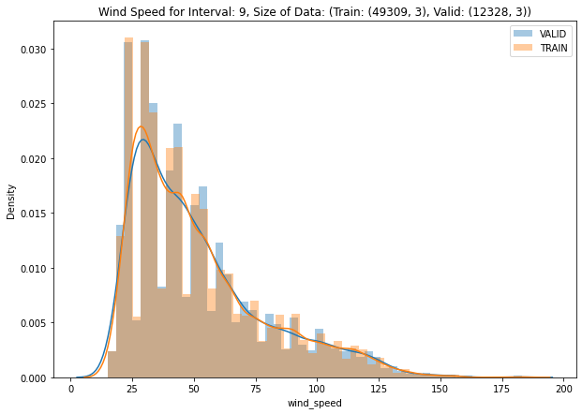
Train v/s Validation data distribution

Slide 4
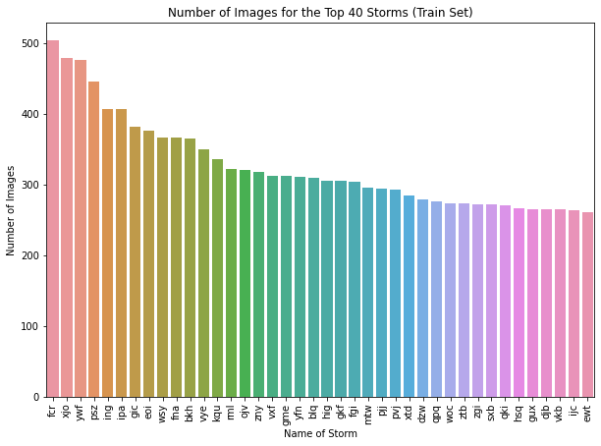
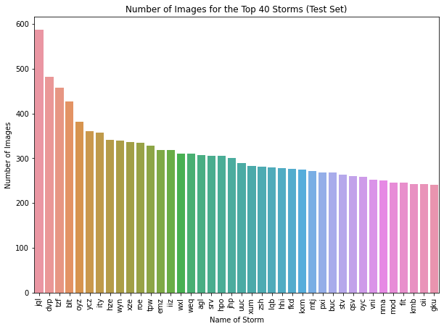
Data Distribution

Slide 5
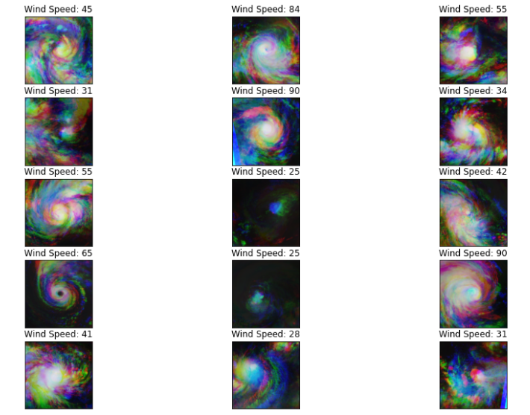
Sample Training Data

Slide 6
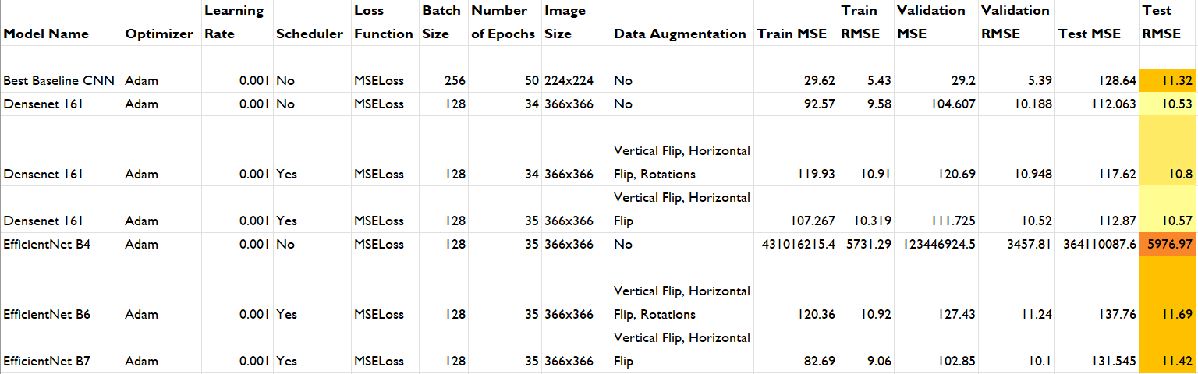
Model Performance Comparison

Slide 7
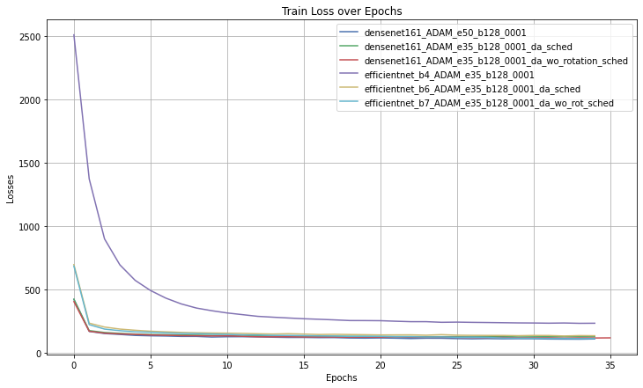
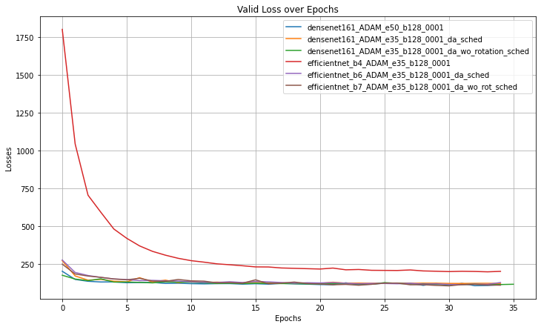
Train loss and Validation loss all models

Slide 8
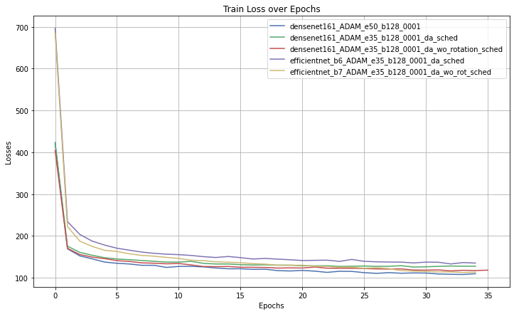
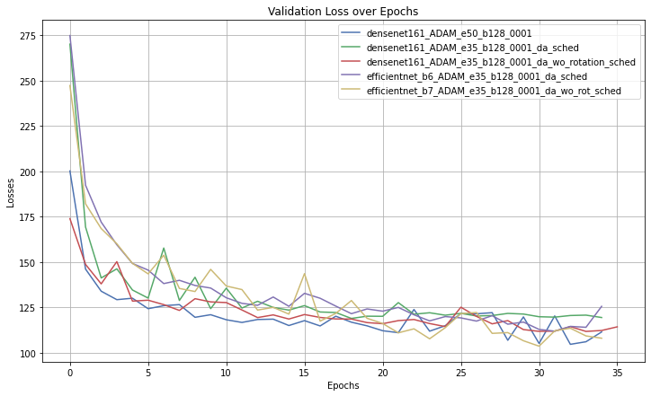
Train loss and Validation loss without efficient net b4

Slide 9
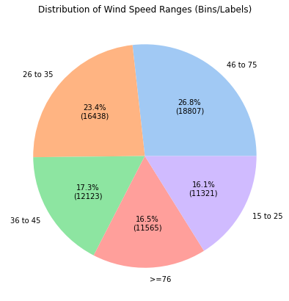
Next Steps

Slide 10
Next Steps
Test out best models for classification, hyperparameter tuning to achieve better performance.
Hyperparameter tuning (for Densenet161 and EfficientNet B7) to get the best model for regression, retrain this model on individual bins, use this for prediction.
Generate a pipeline, evaluate performance.

Slide 11
Thank You

